Slide 1
Extruder

Slide 2
Extruder
Manufacturing
Thermal and Material Properties
Attachment to the UR3e
Notes:
The print head must be aware of its environment
Avoiding collisions
Basis for developing a suitable toolpath
Ranging Scans
Time-of-flight based
Laser Triangulation
Uses geometry of known locations of laser emitter and camera
Tactile Sensing
Thin sheets of force-sensitive resistors

Slide 3
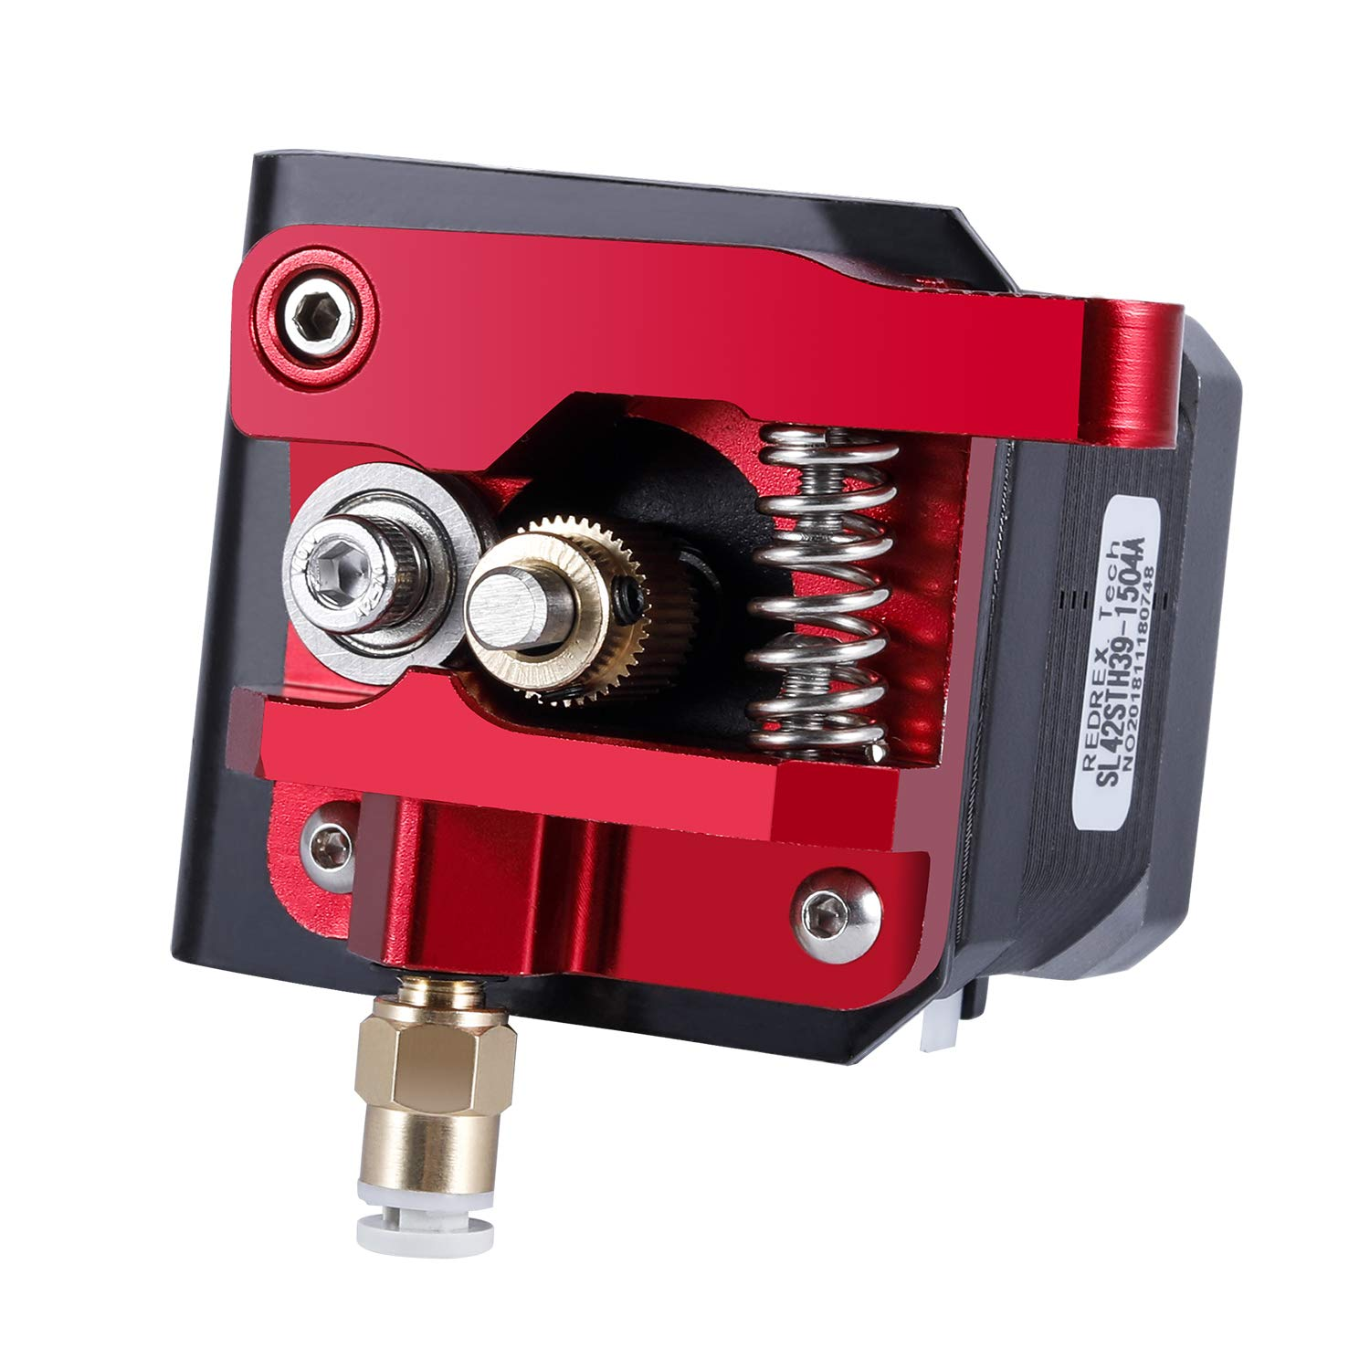
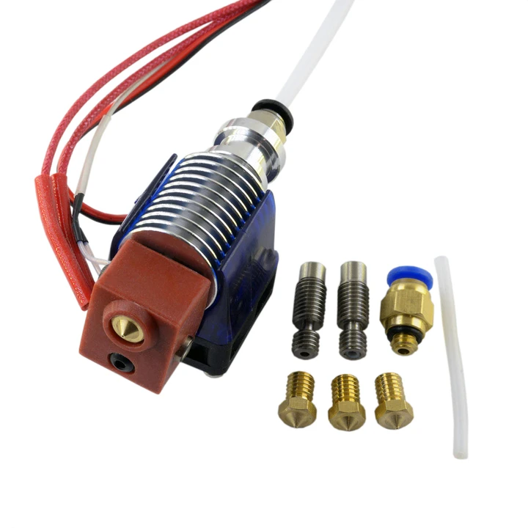
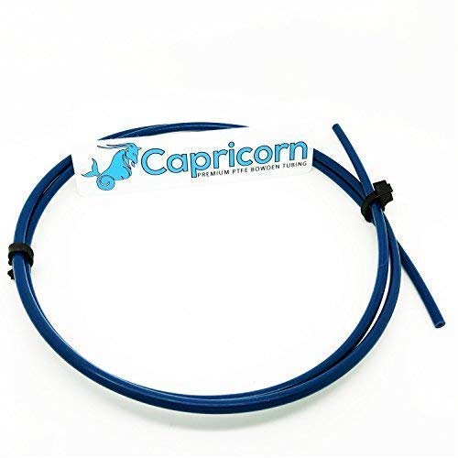
Manufacturing
Assemble premade parts: cold end, hot end, and bowden tube
Revise length of extruder tip
Manually or buy attachment
Cold end: 14 dollars Hot end: 25 dollars
Bowden tube: 12 dollars

Slide 4
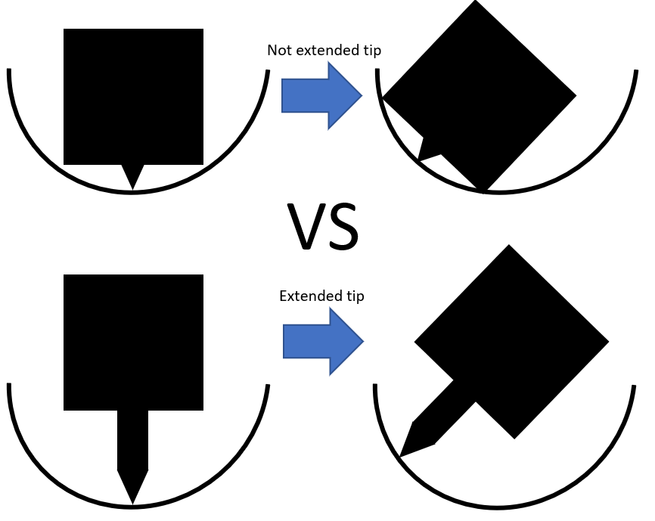
Manufacturing Extruder tip
Extended extruder tip benefits:
3D printer has better maneuverability
Extruder body won’t get stuck on the base

Slide 5
Material and Thermal Properties
PLA melting point: ~190 Celsius
Copper has excellent thermal properties
Can estimate necessary energy intake
Notes:
If you heat one end of copper, the other end will quickly reach the same temperature. Heating the copper extension and maintaining heat should not be a problem. If it is, we can use additional sources of heating (wrapping a coil of wire around the copper)
Calculated from our estimates (depending on how thick the walls of the copper are) that it will require about

Slide 6
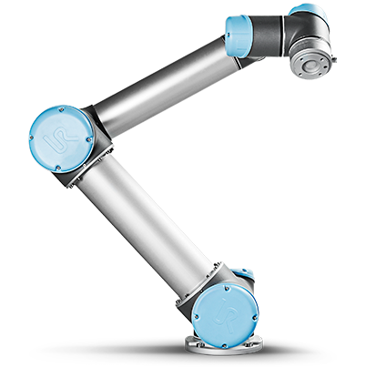
Creating an Attachment
Utilize the UR3e User Manual
CAD dimensions on Inventor
Use Makerbot to print attachment
Notes:
Sharing the bot will be of the utmost importance for us and we need to have an attachment in order to ensure other groups can use the arm as well.

Slide 7
Testing
Independent flow rate tests
Integrated testing with structures
Arm velocity, stability, accuracy
Notes:
Sharing the bot will be of the utmost importance for us and we need to have an attachment in order to ensure other groups can use the arm as well. If the arm is moving too fast for the printer.

